Slide 1
Emergency Call
101.455 Modellig and Simulation
2016W
Group 14

Slide 2
Content
Software Used
Task Description
Implementation
Statistics
Demo
References

Slide 3

Software Used
Simulation tool that supports
System Dynamics
Discrete Events
Agent-Based

Slide 4

Task Description
Call received every 50 min
Normal patients and life-threatening patients
Calls are collected in queue
Doctor receives the address of the patient and treats him

Slide 5
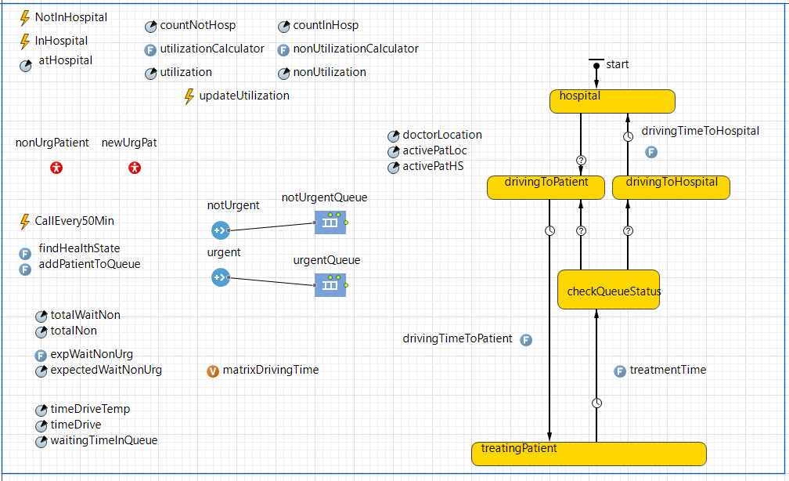
Implementation

Slide 6
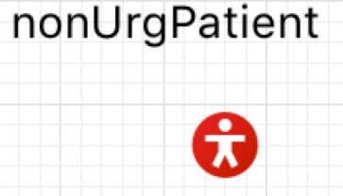

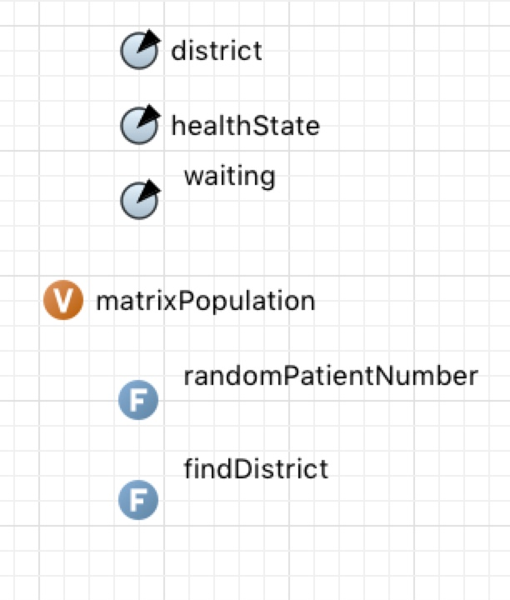
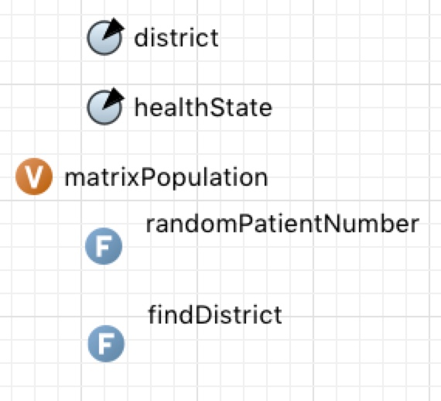
Implementation

Slide 7
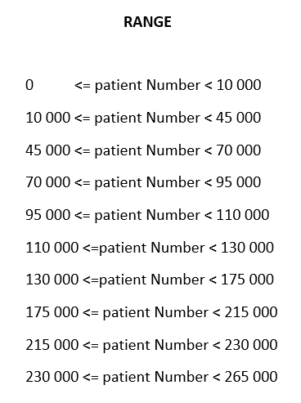
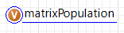
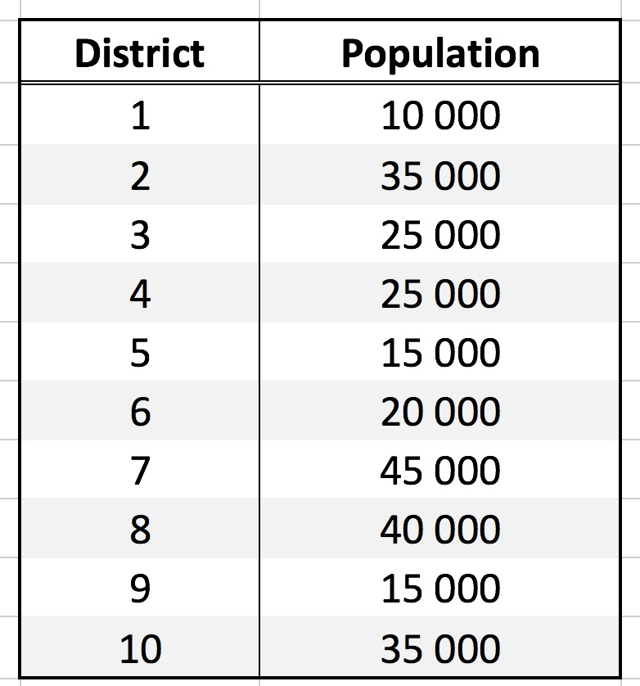
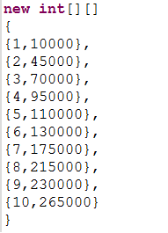
Implementation

Slide 8
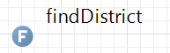
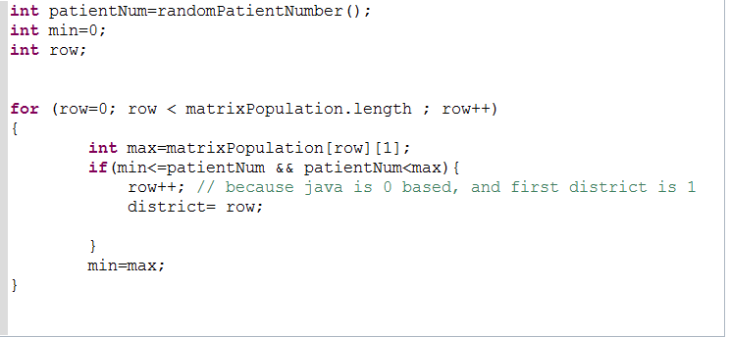
Implementation

Slide 9
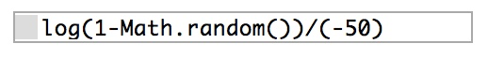
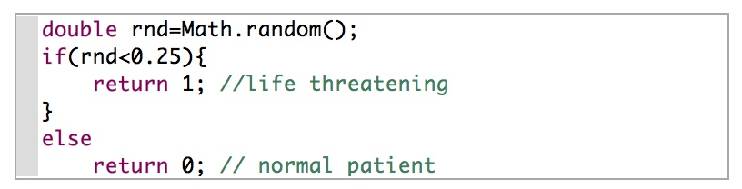
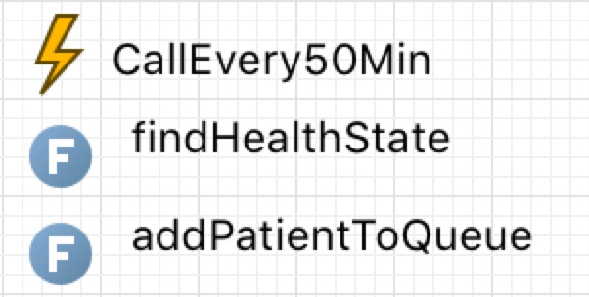
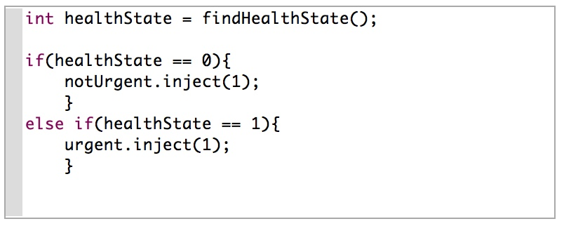
Implementation
callEvery50Min Event

Slide 10
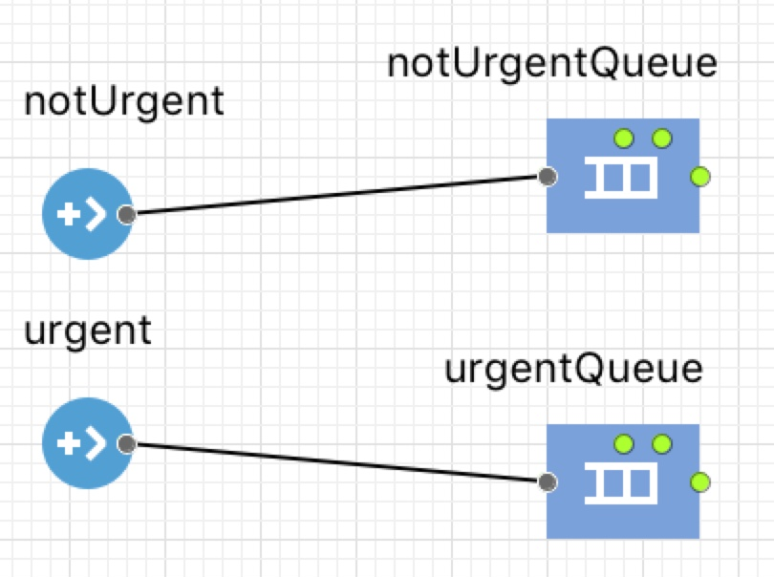
Implementation
Queues
Queue Capacity: 100
Queuing: FIFO principle

Slide 11
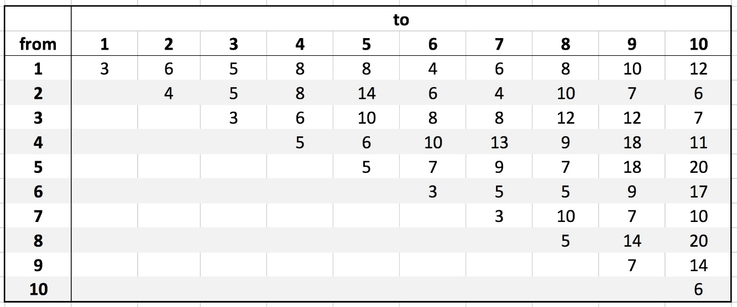
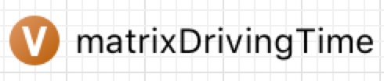
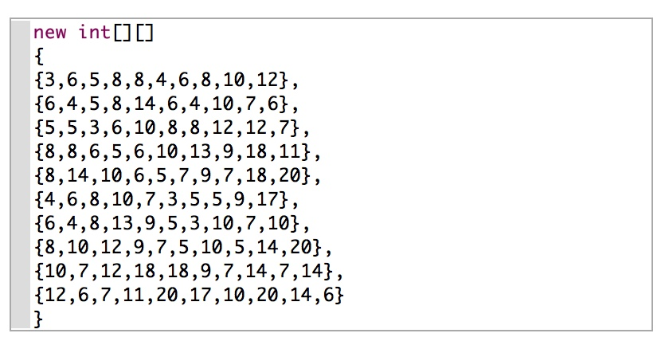
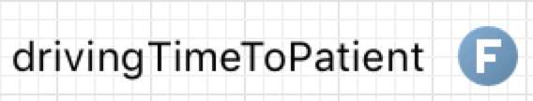
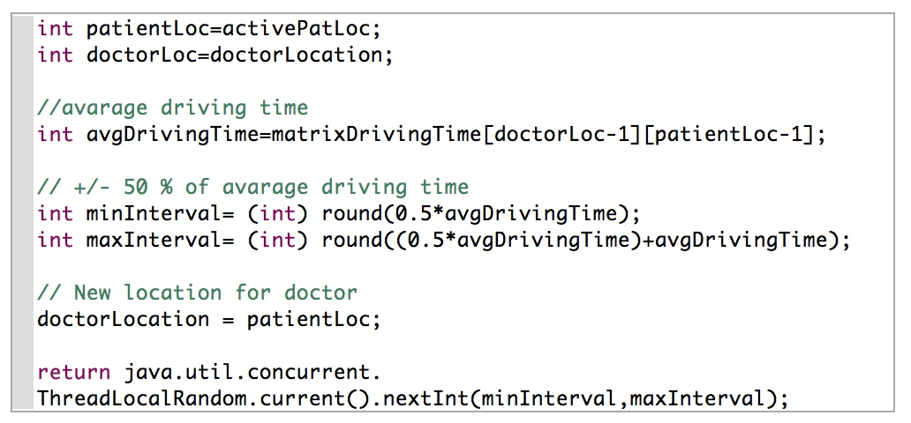
Implementation
Driving time between districts

Slide 12
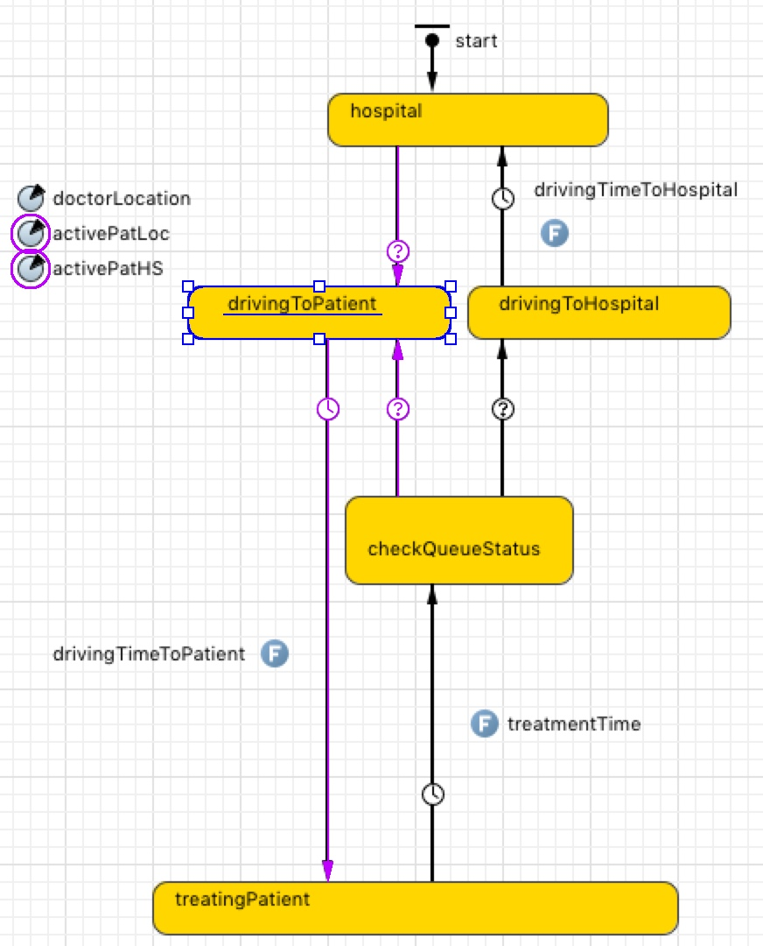
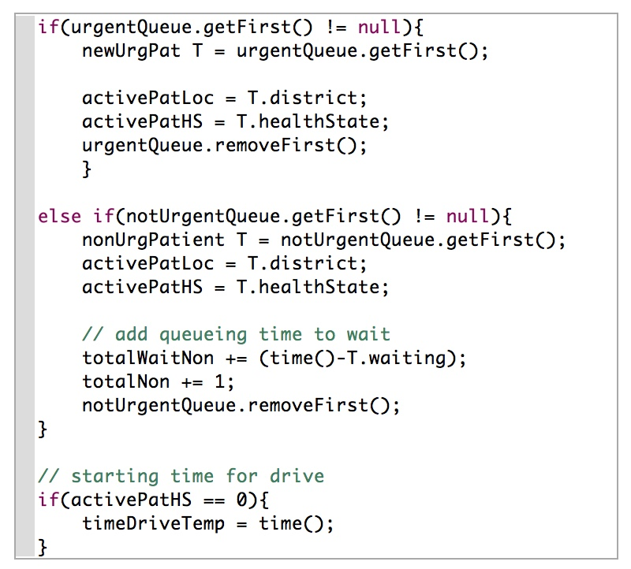
Implementation
drivingToPatient

Slide 13
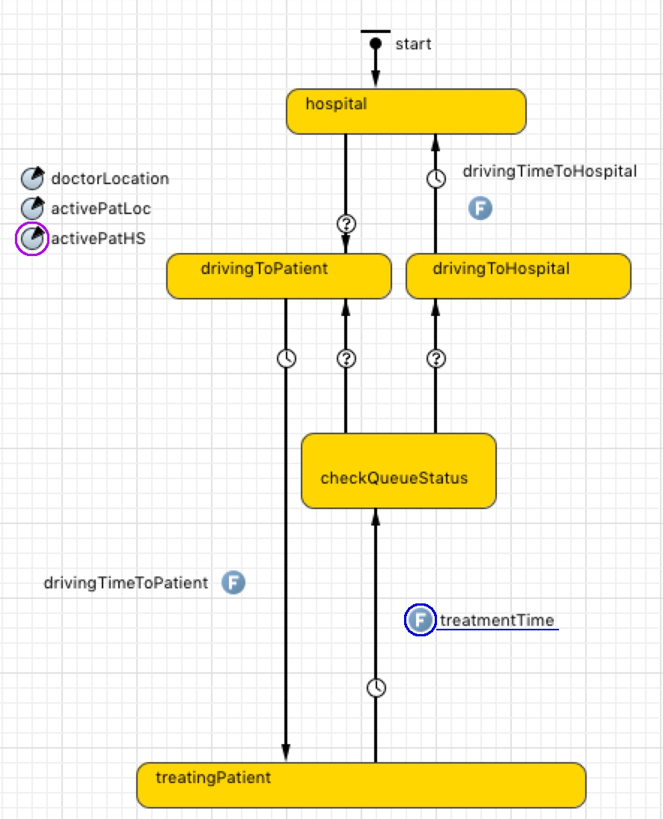
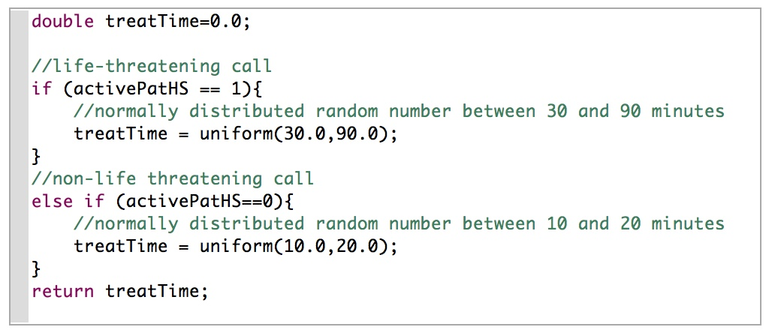
Implementation
treatmentTime

Slide 14
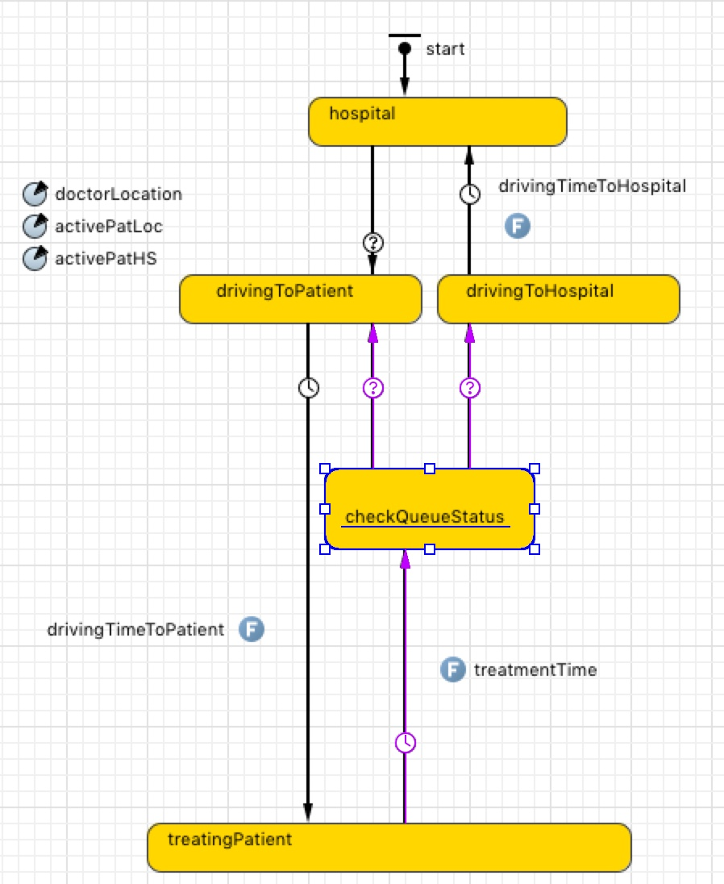
Implementation
checkQueueStatus

Slide 15
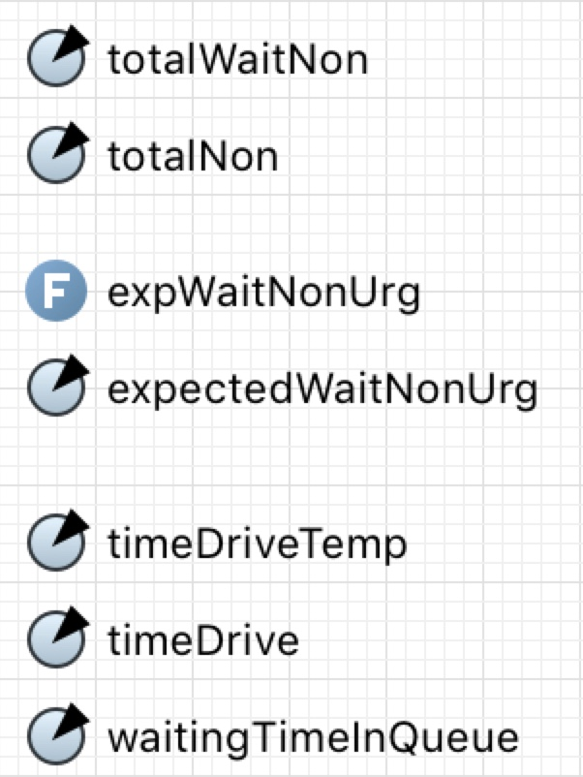
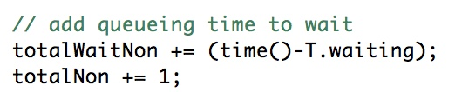
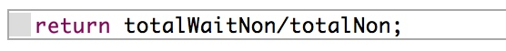
Statistics
Expected waiting time for non-life threatening patient

Slide 16
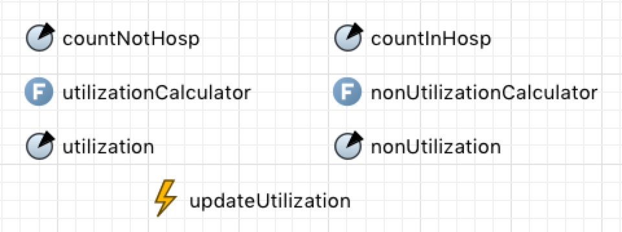
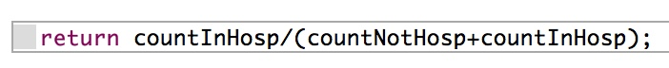
Statistics
Utilization for the doctor

Slide 17
Statistics
Examination of other strategies
Agent Comparison
compares the district of the incoming patient with the patients already in the queue
LIFO
makes sure the last incoming patient gets treated first.
not really fair, but it would be another strategy.

Slide 18
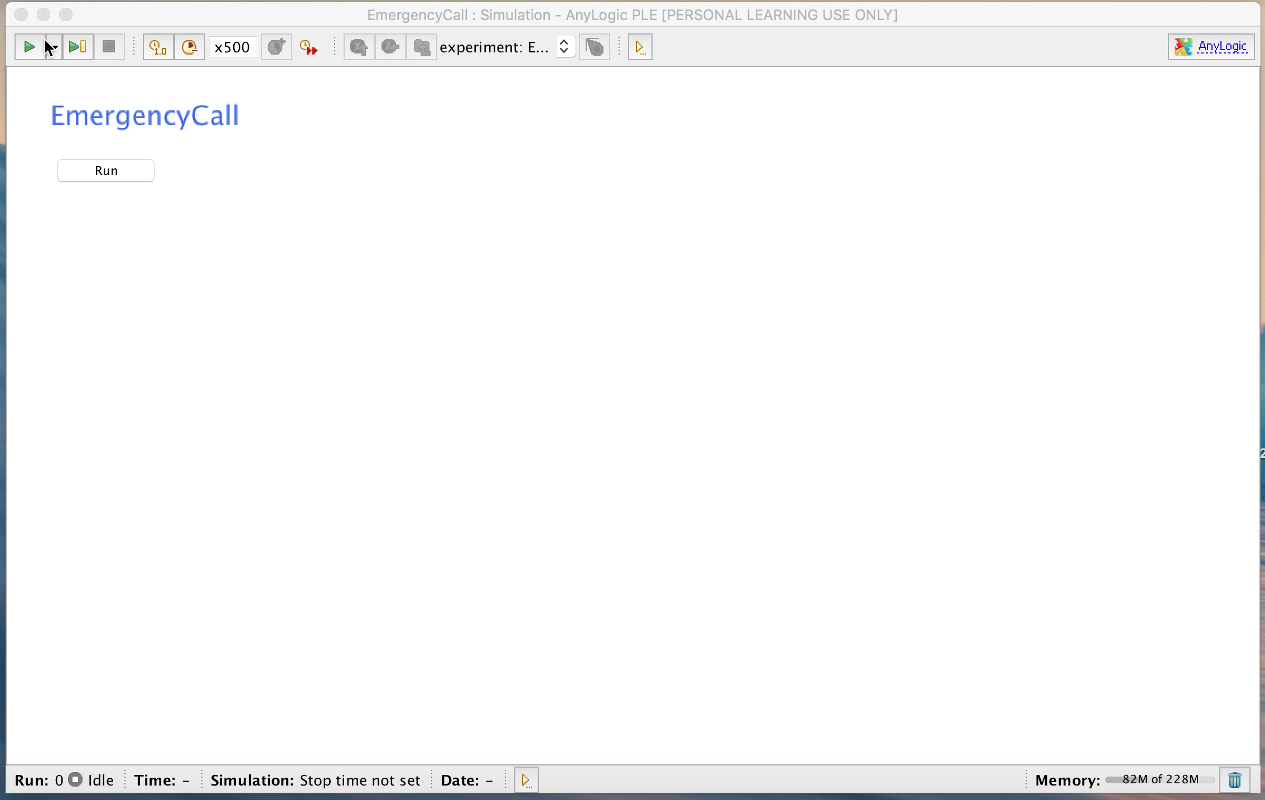
Demo

Slide 19
References
http://www.anylogic.com/about-us
http://help.anylogic.com

Slide 20
Thank you for your attention !

